Slide 1
Interpreting Hemodynamic Data. Pressures Flow and Resistance Estimations
S.RADHAKRISHNAN
FORTIS ESCORTS HEART INSTITUTE AND RESEARCH CENTRE, NEW DELHI

Slide 2
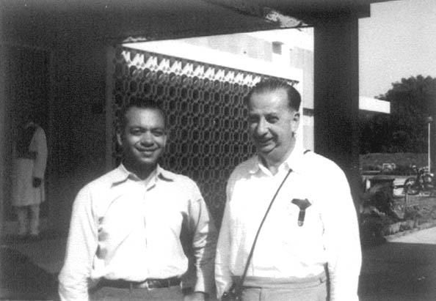
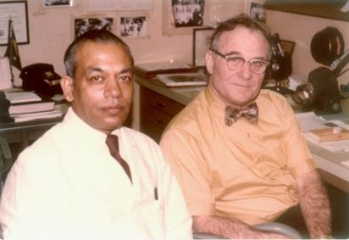
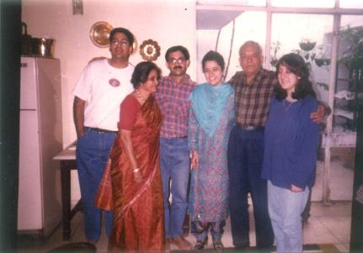
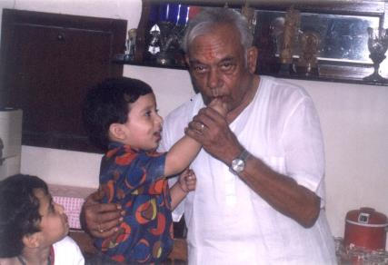
PROF R TANDON 1928- 2014. FRIEND AND MENTOR

Slide 3
Questions: Before, During and After Catheterization
Why are we catheterizing this patient with congenital heart disease?
What specific information is being sought?
What factors can influence interpretation of the information?

Slide 4
Why are we Catheterizing this patient with Congenital Heart Disease?
So that we can take a better informed decision on management

Slide 5
Why are we catheterizing this patient with Congenital Heart Disease?
What are the indications for performing Cardiac Catheterization?
Anatomic Definition (Angiography)
Physiologic Quantification (Hemodynamics)
Pressure
Flows
Resistances

Slide 6
PRESSURES
Catheter tipped manometers are still considered gold standard. Rarely available in clinical setting
Fluid filled tubings and catheter are prone to errors
Great pains to be taken to minimize errors
Level of transducer in relation to chest
Constant check on calibration and zeroing during procedure
Recognize under and over damping of pressures and correct

Slide 7
Why are we catheterizing this patient with Congenital Heart Disease?
Flows and Resistances:
Operability in borderline situations
Before single ventricle palliation (Glenn / Fontan)

Slide 8
When Do We Need to Catheterize Patients With Left to Right Shunts?
Operable
Clear clinical /noninvasive evidence of a large left – right shunt. Typically younger patients
Borderline situation: PVR elevated by clinical/non-invasive assessment. Degree of elevation of PVR (and therefore operability) uncertain.
Inoperable: Eisenmenger physiology
Clear evidence of shunt reversal resulting from high PVR. Typically older patients

Slide 9
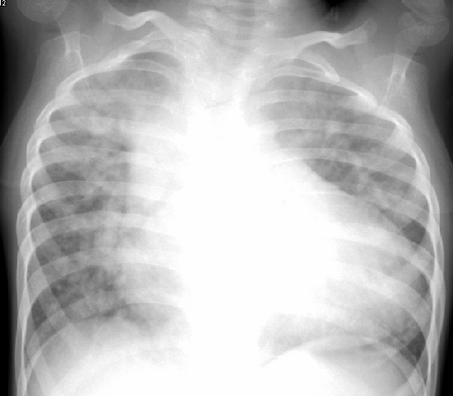
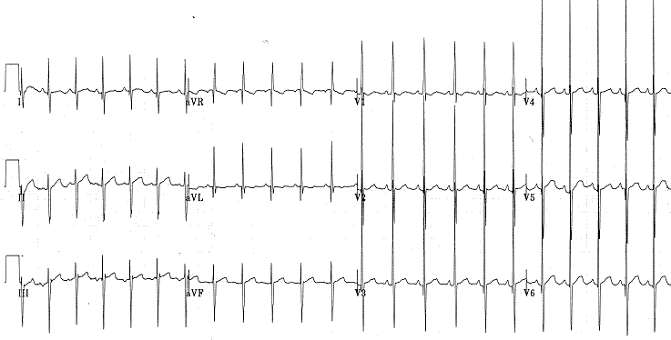

Slide 10
RA
LA
RV
RV
LV
LV
Clearly Operable: Cath not required

Slide 11
When Do We Need to Catheterize Patients With VSD, PDA?
Operable
Clear clinical /noninvasive evidence of a large left – right shunt
Failure to thrive, ↑ precordial activity, mid diastolic murmur at apex,
Cardiac enlargement, ↑pulmonary blood flow
Q in lateral leads on ECG, good LV forces
LA/LV enlargement, exclusively L-R flows across the defect
Borderline clinical non-invasive data: uncertain operability
Cyanosis, desaturation at rest (<93%) or on walking, quiet precordium, no MDM
Normal heart size, peripheral pruning
No Q in lateral leads, predominant RV forces
No LA LV enlargement, significant R-L flows across the defect
Clear evidence of shunt reversal resulting from high PVR.
Inoperable

Slide 12
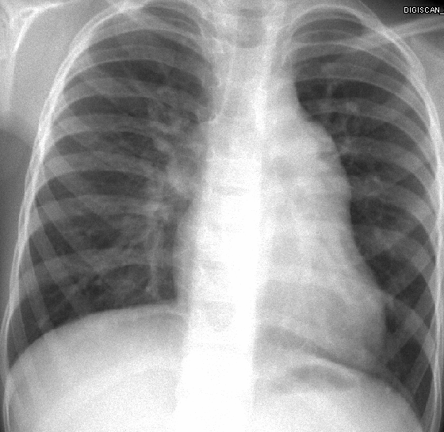
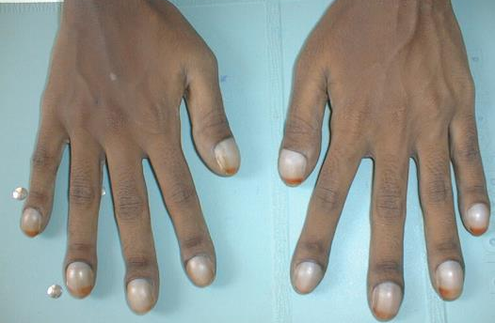
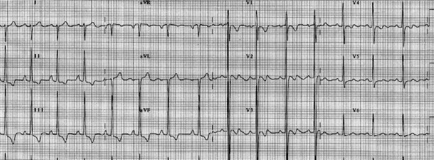
26 year old
Blue
Single loud S2

Slide 13
LA
RA
RV
LV
Clearly Inoperable: Cath not required? Sometimes performed before “labeling as inoperable”

Slide 14
14-year-old boy
19.7 Kg
Pink (95%)
Closely split S2
Loud P2
No apical MDM,
ECG RVH, no Q in lat leads

Slide 15
RA
LA
RV
LV

Slide 16
PA
RV
Ao
LV
Ao
PDA
LA
Operability Uncertain :
Cardiac cath recommended

Slide 17
Questions: Before, During and After Catheterization
Why are we catheterizing this patient with congenital heart disease?
What specific information is being sought?
What factors can influence interpretation of the information?

Slide 18
What Specific Information is being sought?
How much is the shunt?
- Ratio of pulmonary to systemic blood flow (Qp: Qs ratio)
PVR / PVRI; PVR/SVR ratio?
Ventricular end diastolic pressure (for Single Ventricle physiology)

Slide 19
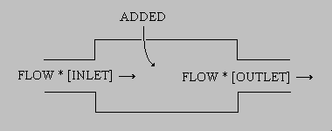
Flow Calculations
Applying Fick’s Principle
Oxygen Consumption
Flow =
O₂ content 1
O₂ Content 2

Slide 20
Flow Measurements: O₂ Content
O₂ Content (ml of O₂ per 100 ml of blood)
Hb (gm/100 ml of blood) X 1.36 X fractional saturation of blood
+
Dissolved Oxygen in plasma

Slide 21
Dissolved O₂
0.003 ml of O₂ is dissolved in 100 ml plasma for every torr (mm Hg) of Oxygen tension
Should be taken into consideration whenever PO₂ exceeds 100 mm Hg after O₂ is administered

Slide 22
Oxygen Saturation Measurements
Direct saturation measurements and not ABGs
Saturations should be measured in the lab
Spectrophotometer (measures absorption of transmitted light at a given wavelength)

Slide 23
HEAMOXYMETER

Slide 24
Flows
Systemic blood flow (cardiac output)
Oxygen consumption
Arterial O2 content
Mixed V O2 Content
Pulmonary blood flow
Oxygen consumption
PVO2 content
PA O2 Content

Slide 25
Flows
Systemic blood flow (cardiac output)
Oxygen consumption
(Ao sat – MV sat) (Hb conc) (1.36) (10)
Pulmonary blood flow
Oxygen consumption
(PV sat – PA sat) (Hb conc) (1.36) (10)

Slide 26
Shunt Ratio (Qp/Qs)
Only O₂ saturations are needed
Aortic sat – Mixed Venous sat
Pulmonary Venous sat – PA sat

Slide 27
Shunt Calculations in admixture lesions
Effective Systemic (QeS) or Pulmonary blood flow (QeP)
Oxygen Consumption
(PV sat – MV sat) (Hb conc) (1.36) (10)
L-R Shunt = Qp – Qep; R-L shunt = Qs - Qes

Slide 28
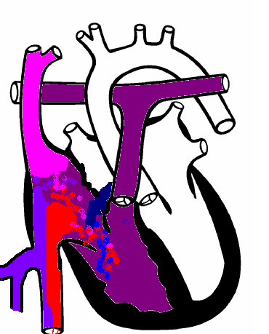
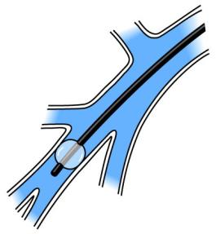
Flow Calculations: Sources of Error
Sampling for O₂ saturation estimation
Streaming
Partial wedging

Slide 29
O₂ Saturation Errors
Getting samples in different physiologic states
Diluted samples
Air bubble in syringe
Delay in sending samples
Machine calibration
Extrapolating from ABG
Failure to account for dissolved O2
Carboxyhemoglobin

Slide 30
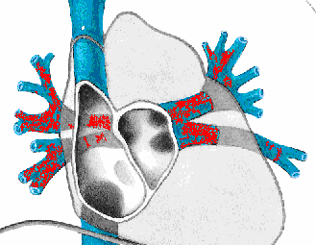
O₂ Saturation Errors
Non representative sampling
Pulmonary vein
Right atrium
IVC
Aorta in presence of
PDA with R-L flow

Slide 31
Mixed Venous Saturation
In absence of L - R shunt: PA
In presence of L - R shunt:
?SVC
? Flamm Formula (3 SVC +1IVC / 4)
Anesthesia

Slide 32
Oxygen Consumption
Measured:
Douglas bag, Spirometer
Flow through devices (Waters; Sensormedics)

Slide 33
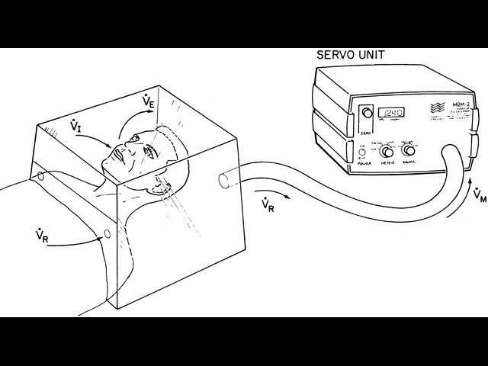
Oxygen Consumption

Slide 34
Oxygen Consumption
Assumed:
Older Patients: Tables, Formulae of LaFarge and Miettinen
HR, age, sex, wide standard deviation
Infants: Crude approximations
2-5 Kg: 10-14 mlO2/Kg
5-8 Kg: 7-11 mlO2/Kg
** Assumed oxygen consumption on O2 is NOT RECOMMENED

Slide 35
Flow Calculations: Limitations
Errors in oxymetry
Assumptions:
O₂ Consumption
PV O₂ saturation
High flows (limits use of Fick’s method)

Slide 36
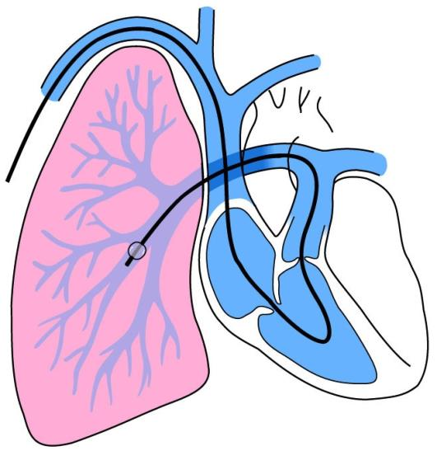
Sampling Sequence
1
3
1
?2

Slide 37
What is a Significant Step-up? Shunt detection by oxymetry
Chamber Sampled | Minimum Difference | Multiple Samples
SVC-RA | 8.7% | 7%
RA-RV | 5.2% | 4%
RV -PA | 5.6% | 4%

Slide 38
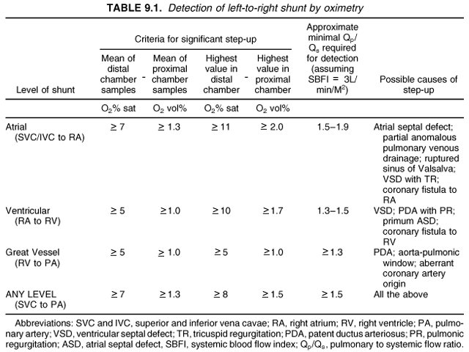
Criteria for step-up

Slide 39
PVR Estimation
Pulmonary artery mean pressure
Pulmonary venous mean pressure
Trans-pulmonary gradient
PVR =
Pulmonary blood flow
Oxygen consumption
PVO₂ content
PA O₂ Content

Slide 40
Determinants of Pulmonary Vascular Resistance (PVR)
↑ PVR | ↓ PVR
Hypoxia | Oxygen
Hypercarbia/acidosis | Hypocarbia/Alkalosis
Hyperinflation | Normal FRC
Atelectasis | Nitric Oxide
High hematocrit | Low hematocrit

Slide 41
Left to Right Shunts: Conditions that increase PVR
Lung infections
Hypoventilation
Upper airway obstruction
Skeletal deformities of chest wall
Deep sedation
Chronic lung disease
Underdeveloped lungs
Pulmonary venous obstruction

Slide 42
Heart Lung Interactions: L - R Shunts with Hypoventilation
Infants with Trisomy 21
VSD, Common AV canal and PDA
Hypoventilation from upper airway obstruction is very common
Resting elevation of PVR because of low PO₂ and high PCO₂
Problem exaggerated by sedation (during cath and echo)

Slide 43
Heart Lung Interactions: L-R Shunts with Hypoventilation
Trisomy 21
Pierre-Robin Syndrome
Neurogenic hypoventilation
Skeletal deformities (Kyphoscoliosis)
Assessment of operability and decision making can be very difficult

Slide 44
Special maneuvers in Cath lab
PDA occlusion to assess operability
Temporary occlusion of fenestrated Fontan to assess suitability of closure
Temporary occlusion of venous collaterals (pop off channels) post Glenn operation

Slide 45
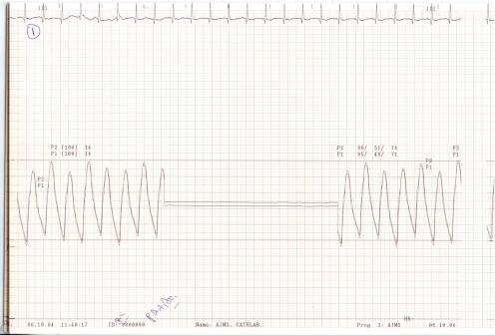
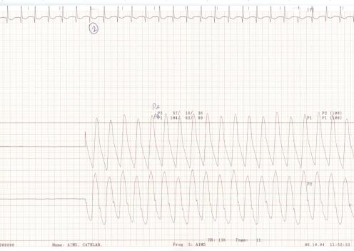

Slide 47
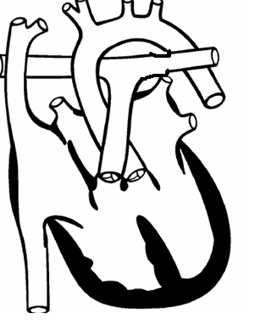
80
Qp/Qs =
97-72 / 98-86 = 25/12
~2:1
97
40
72
Cardiac Index: 3.2l/min/m²
Qp = 6.4 l/min/m²
86
16
98
8
PVRI =
40-16/6.4; 24/6.4 = 3.75 wood units (mmHg/l.min.m2)
80

Slide 48
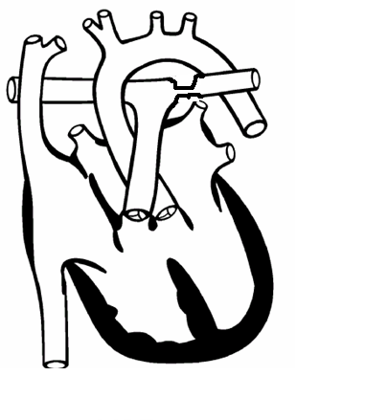
80
97
40
72
86
16
98
8
80

Slide 49
PVR assessment in the presence of asymmetric pulmonary blood flows
Rt
Lt
1/PVR = 1/pvr(rt) +1/pvr(lt)

Slide 50
Some rules in interpreting hemodynamic data
Pressures: Normal/high or low
Gradients if any
Trans-pulmonary gradient
Diagnostic possibilities (keep this for the end)

Slide 51
Some rules in interpreting hemodynamic data
Background Knowledge -
All normal values
Pressure recordings, principles and sources of error
Principles of flow and resistance calculations, sources of error
Principles of valve area calculations, sources of error

Slide 52
Some rules in interpreting hemodynamic data
Look at one parameter at a time:
Oxygen saturations followed by pressures
SVC sats: Normal High or low
Is there a significant step-up downstream at all levels
Is there a step-down in the sats
Quick calculation of Qp/Qs

Slide 53
SUMMARY
Cardiac Cath in patients for CHD is a cumbersome process
Inherent errors at all steps
Every effort to minimize errors
Rapid changes in hemodynamics during procedure should be recognized and efforts made to correct it
Patient should be in as near physiological state as possible (chest infection, fever)

Slide 54
SUMMARY
Need for angiography minimized with availability of alternate modes of imaging
Calculations modules available in computer but important to allow resident to practice manual calculations
Need to further develop techniques like MRI for flow calculation

Slide 55
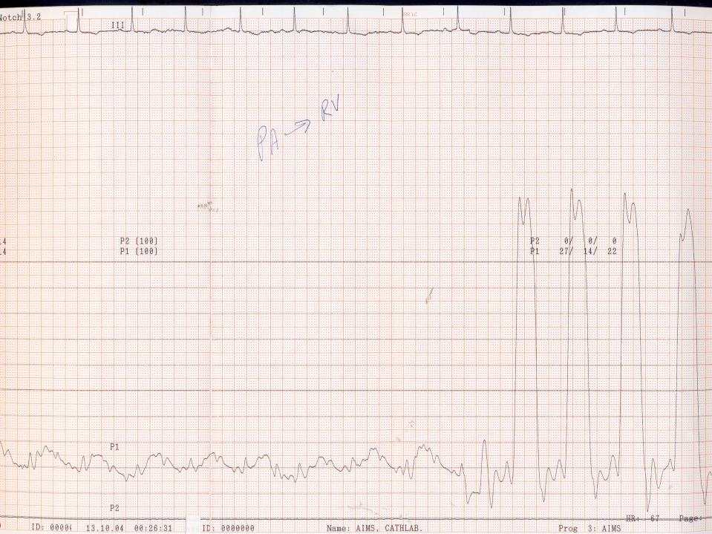
Hemodynamic Tracings
Rhythm on ECG
Scale and paper speed
Chamber: Atrial-venous / ventricular / arterial
Identify waves (in atrial tracings), which is taller
Numbers, normal or elevated
Quality (only if abnormal, under-damped with overshoot, over-damped)
Characteristics of the waves
Respiratory variation, report end expiratory pressure
Effect of ectopic if any
Interpretation
Diagnostic possibilities, there may be more than one!

Slide 56
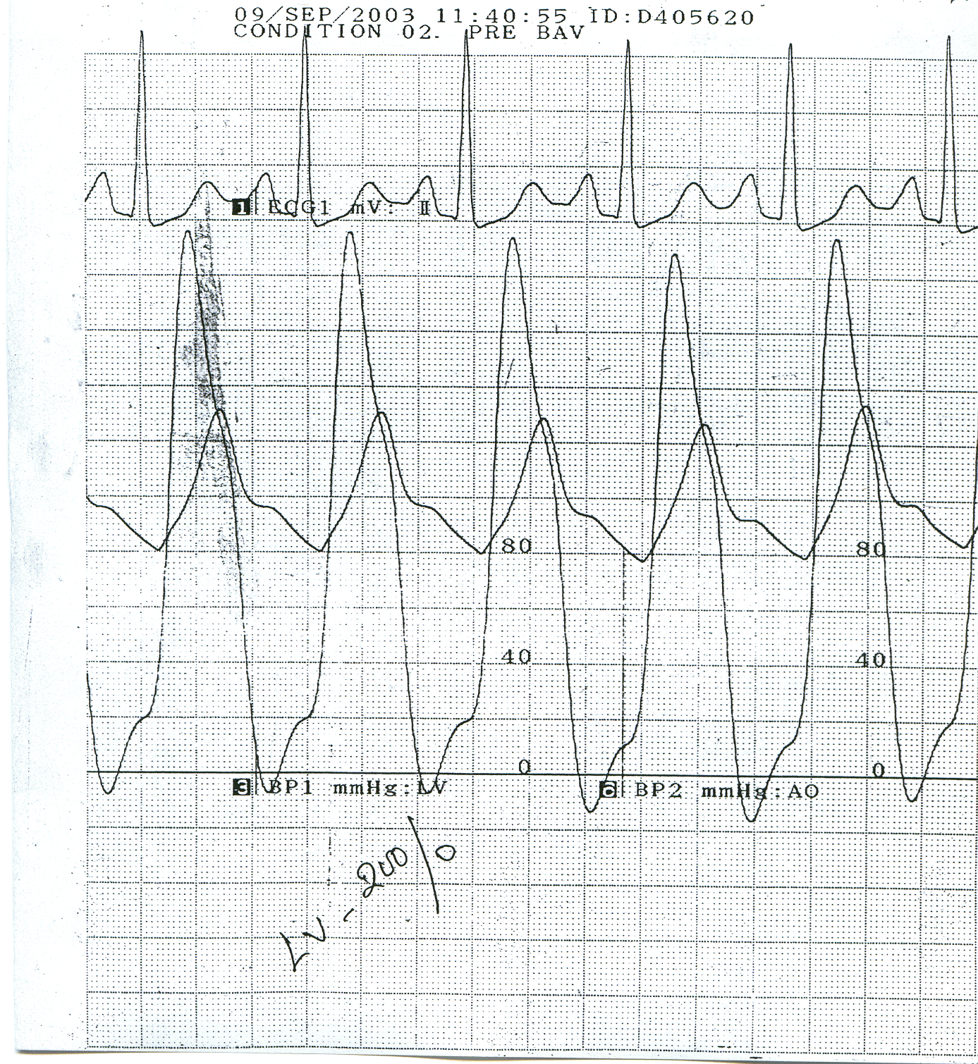
160
120
LV and aortic pressure tracings
What is the diagnosis?

Slide 57
RV to RA pull back tracing

Slide 58
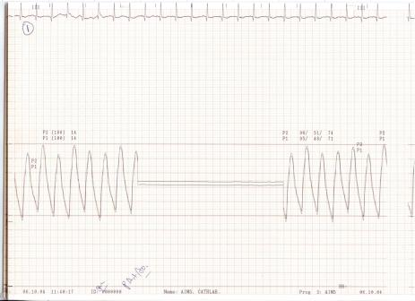

Slide 59
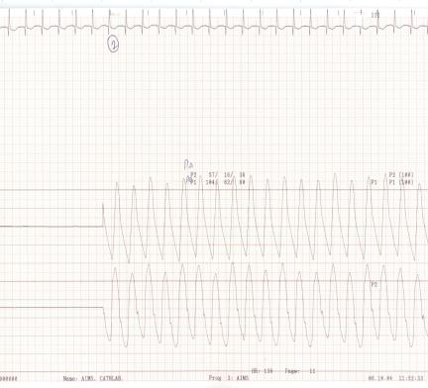

Slide 60
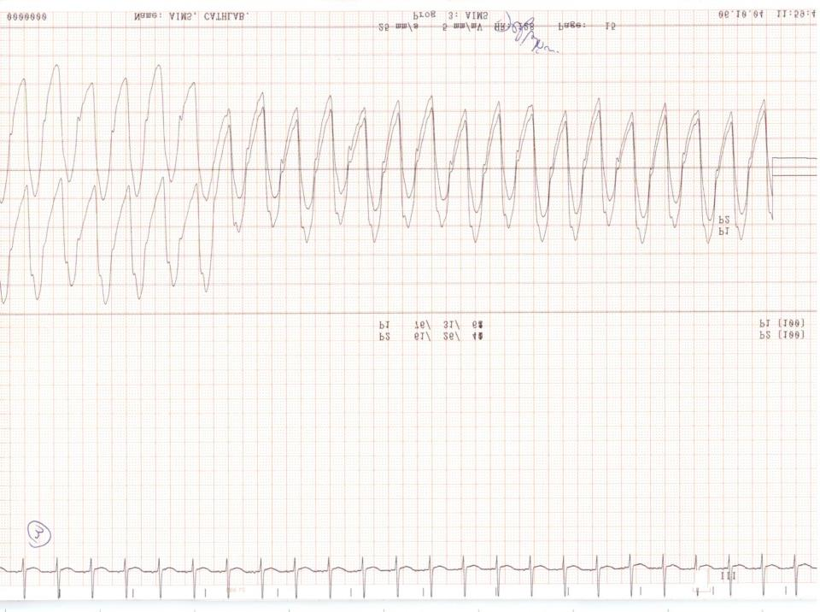
Balloon Occlusion
Balloon deflation
AO
PA

Slide 61
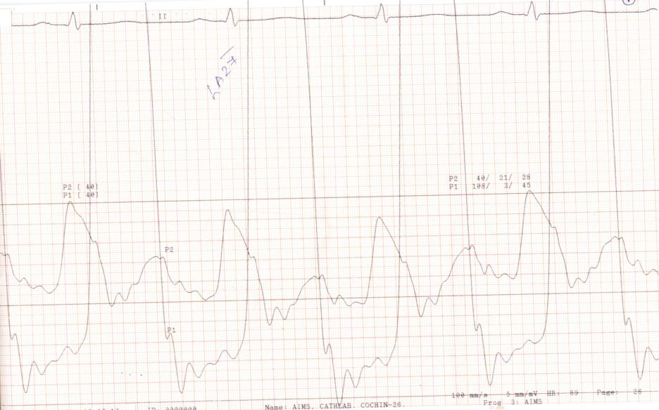
Pre Proc

Slide 62
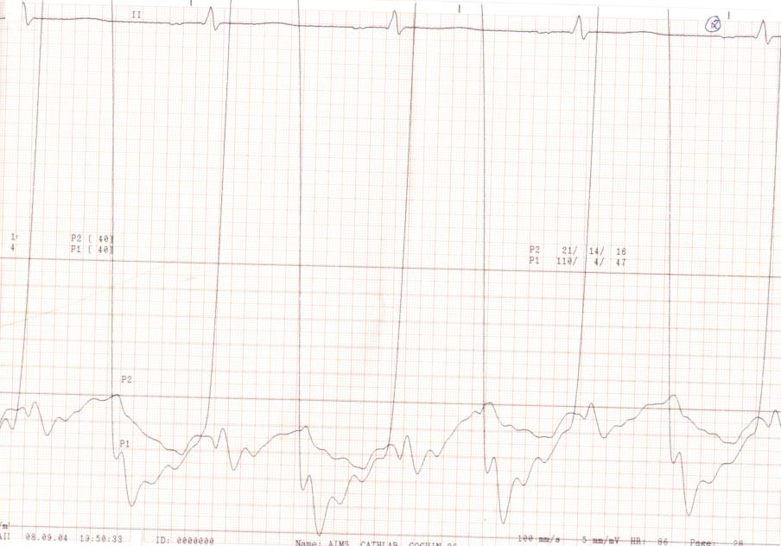
Post Proc

Slide 63
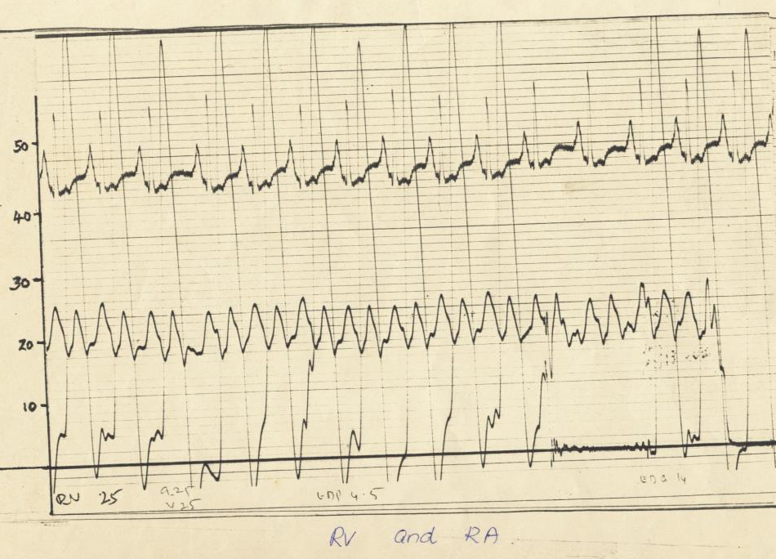

Slide 64
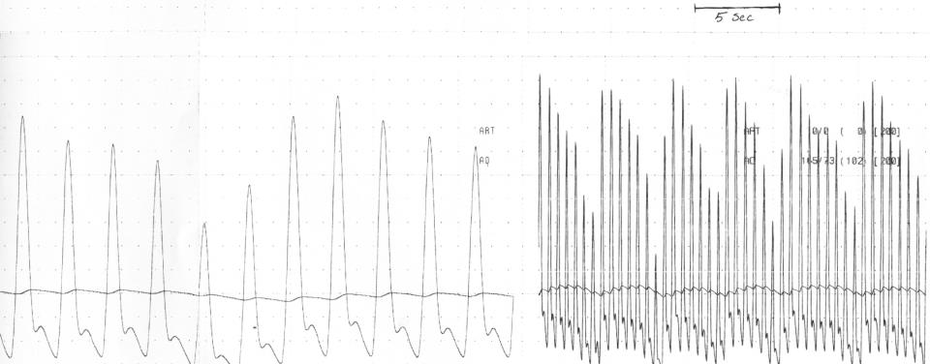
What sign is shown?
Notes:
Before pericardiocentesis.

Slide 65
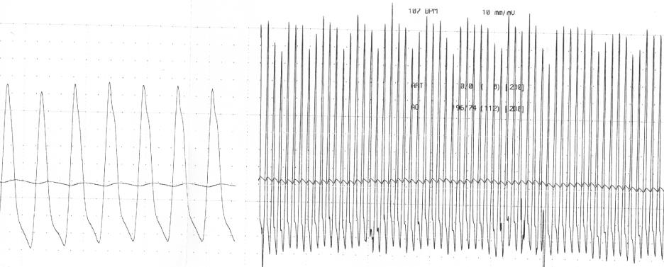
Notes:
After…

