Slide 1
ECGs…
Dr.Sharada, Prof Cardiology,
Saveetha Med College & Hospital
Chennai

Slide 2
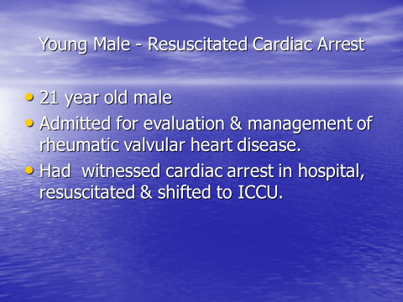

Slide 3
Young Male - Resuscitated Cardiac Arrest
21 year old male
Admitted for evaluation & management of rheumatic valvular heart disease.
Had witnessed cardiac arrest in hospital, resuscitated & shifted to ICCU.

Slide 4
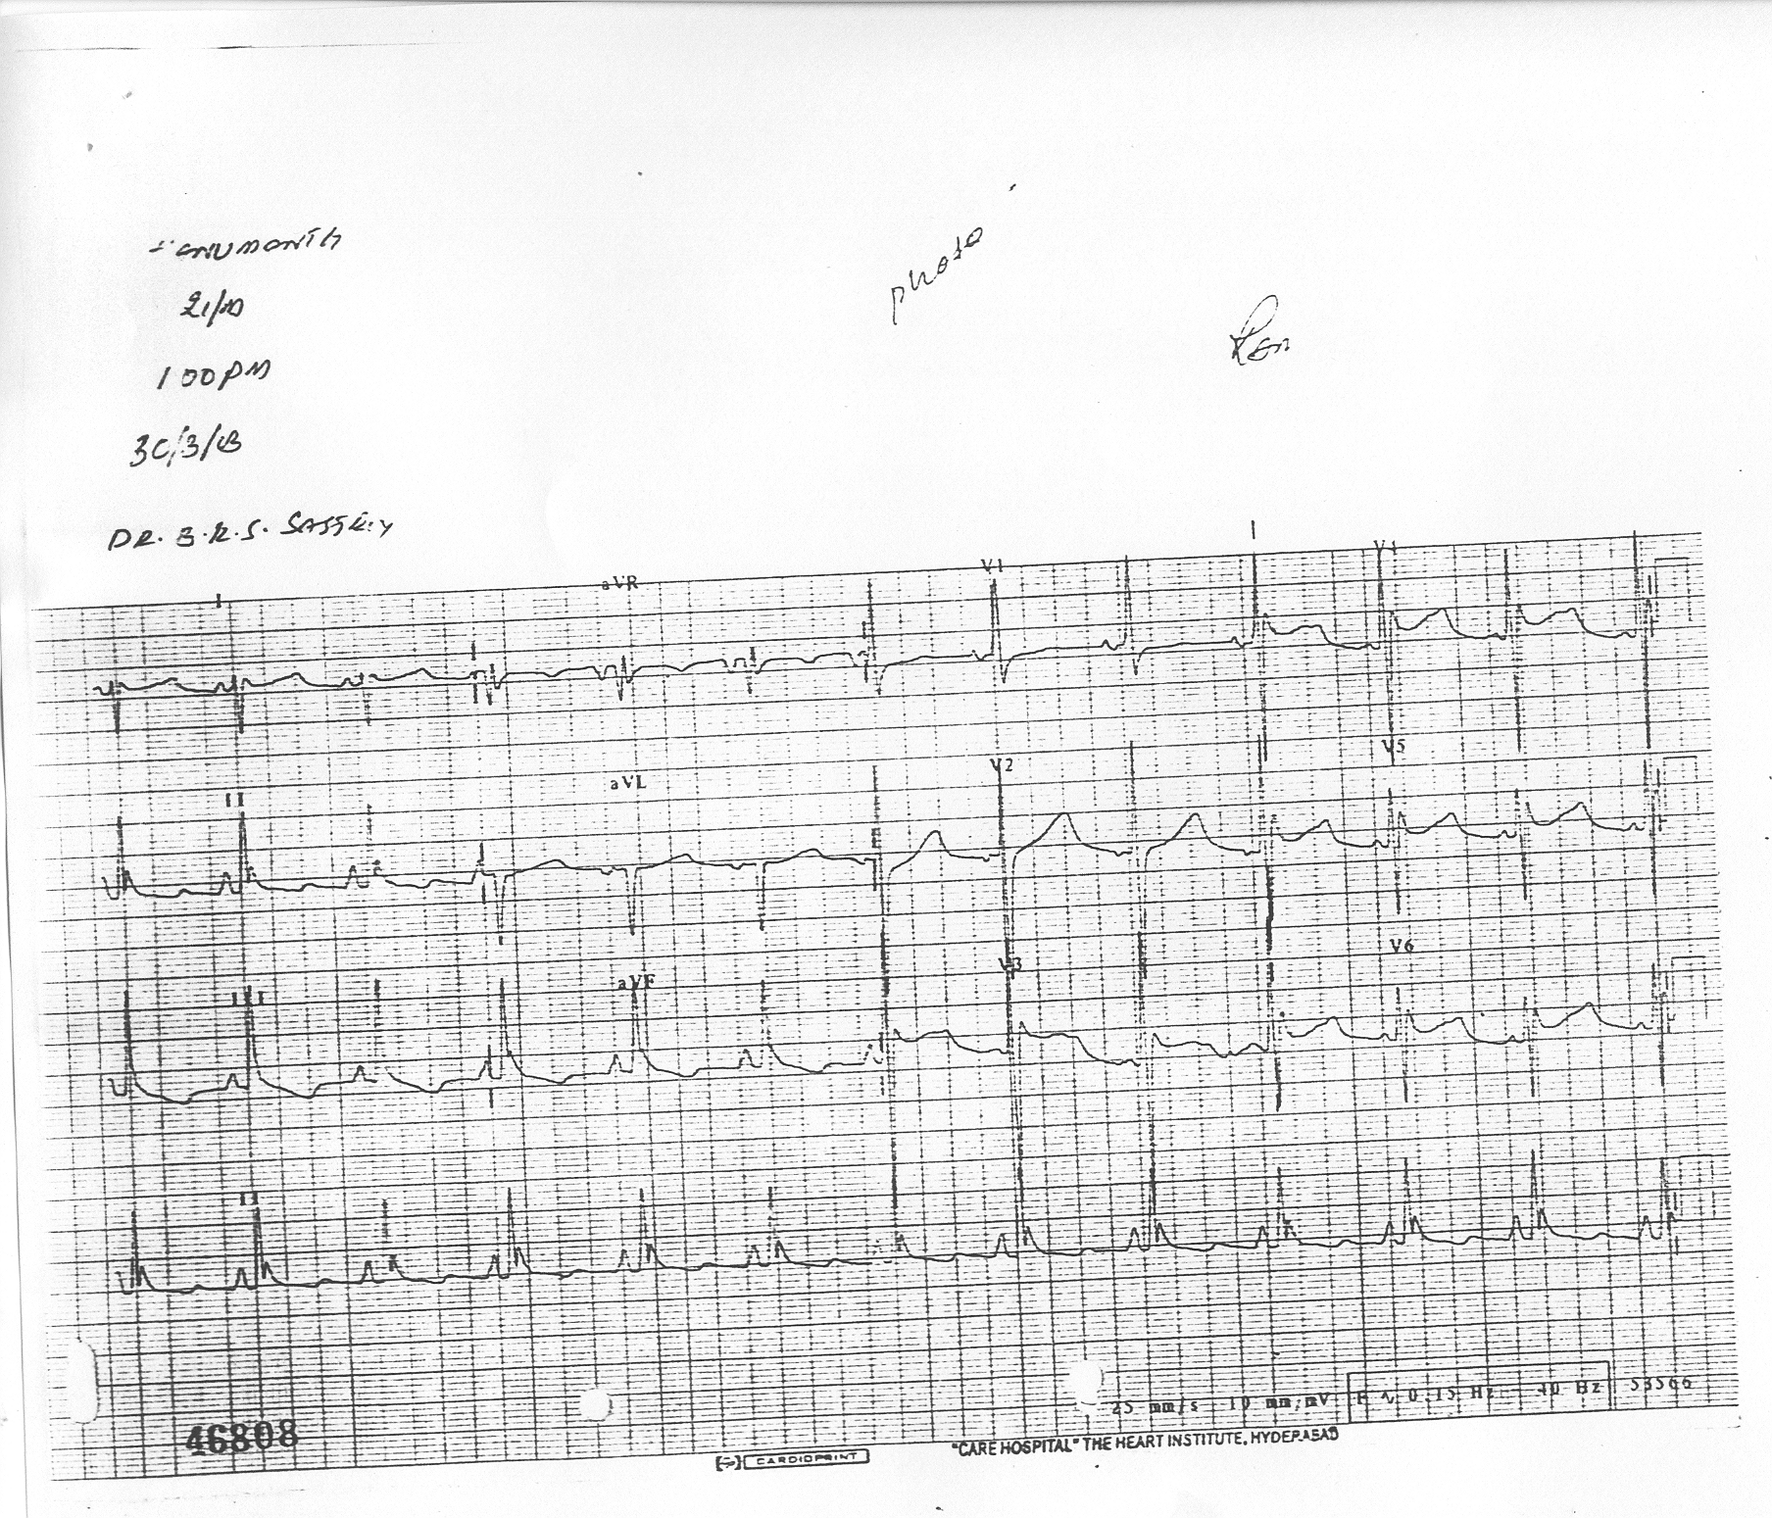
Had A “Therapeutic Procedure” to improve outcomes…
ECG …

Slide 5
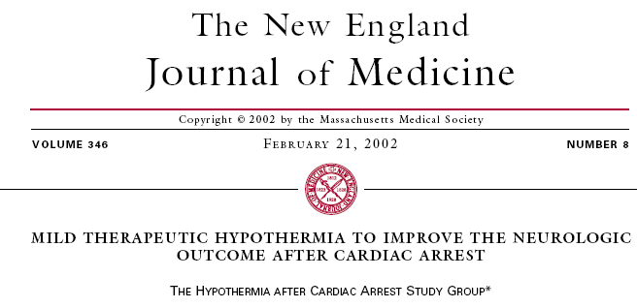
ABSTRACT
Background Cardiac arrest with widespread cerebral ischemia frequently leads to severe neurologic impairment. We studied whether mild systemic hypothermia increases the rate of neurologic recovery after resuscitation from cardiac arrest due to ventricular fibrillation.
Methods In this multicenter trial with blinded assessment of the outcome, patients who had been resuscitated after cardiac arrest due to ventricular fibrillation were randomly assigned to undergo therapeutic hypothermia (target temperature, 32°C to 34°C, measured in the bladder) over a period of 24 hours or to receive standard treatment with normothermia. The primary end point was a favorable neurologic outcome within six monthsafter cardiac arrest; secondary end points were mortality within six months and the rate of complications within seven days.
Results Seventy-five of the 136 patients in the hypothermia group for whom data were available (55 percent) had a favorable neurologic outcome (cerebral-performance category, 1 [good recovery] or 2 [moderate disability]), as compared with 54 of 137 (39 percent) in the normothermia group (risk ratio, 1.40; 95 percentconfidence interval, 1.08 to 1.81). Mortality at six months was 41 percent in the hypothermia group (56 of 137 patients died), as compared with 55 percent in the normothermia group (76 of 138 patients; risk ratio, 0.74; 95 percent confidence interval, 0.58 to 0.95). The complication rate did not differ significantly between the two groups.
Conclusions In patients who have been successfully resuscitated after cardiac arrest due to ventricular fibrillation, therapeutic mild hypothermia increased the rate of a favorable neurologic outcome and reduced mortality.

Slide 6
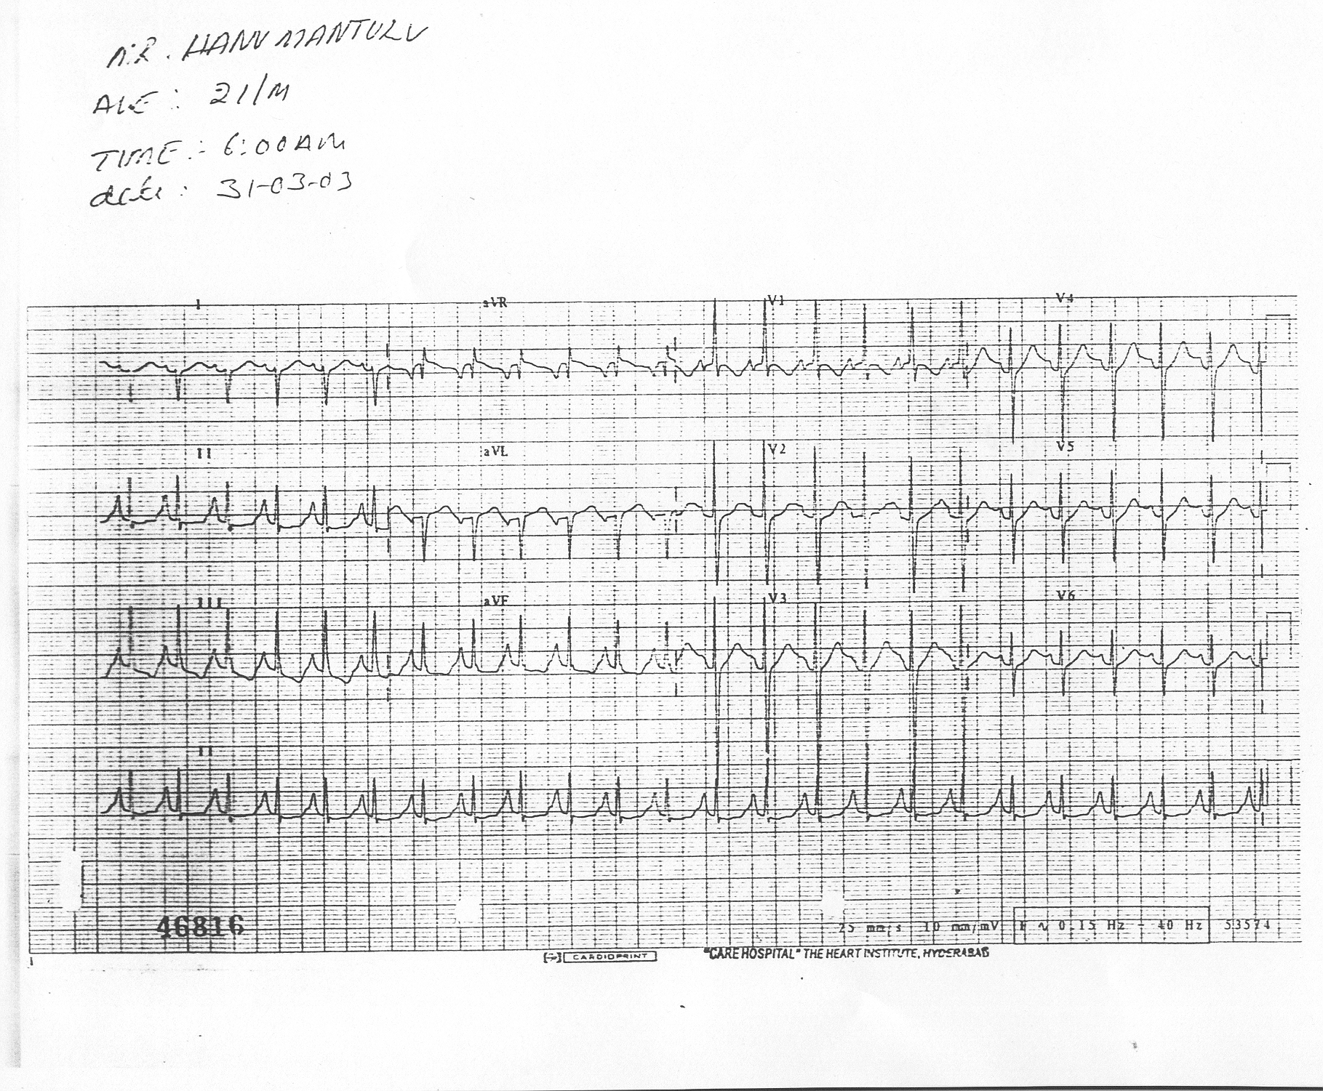
ECG After Stopping Hypothermia

Slide 7
Osborn Wave
Seen in hypothermia (Rectal temperature < 34 ⁰ C / 94 ⁰ F).
Deflection between QRS complex and beginning of ST segment.
Reflects delay of depolarisation, current of injury or early
repolarisation.
Most prominent in V3 and V4.
Amplitude inversely related to body temperature.
All intervals R-R, P-R, QRS, QT lengthen.

Slide 8
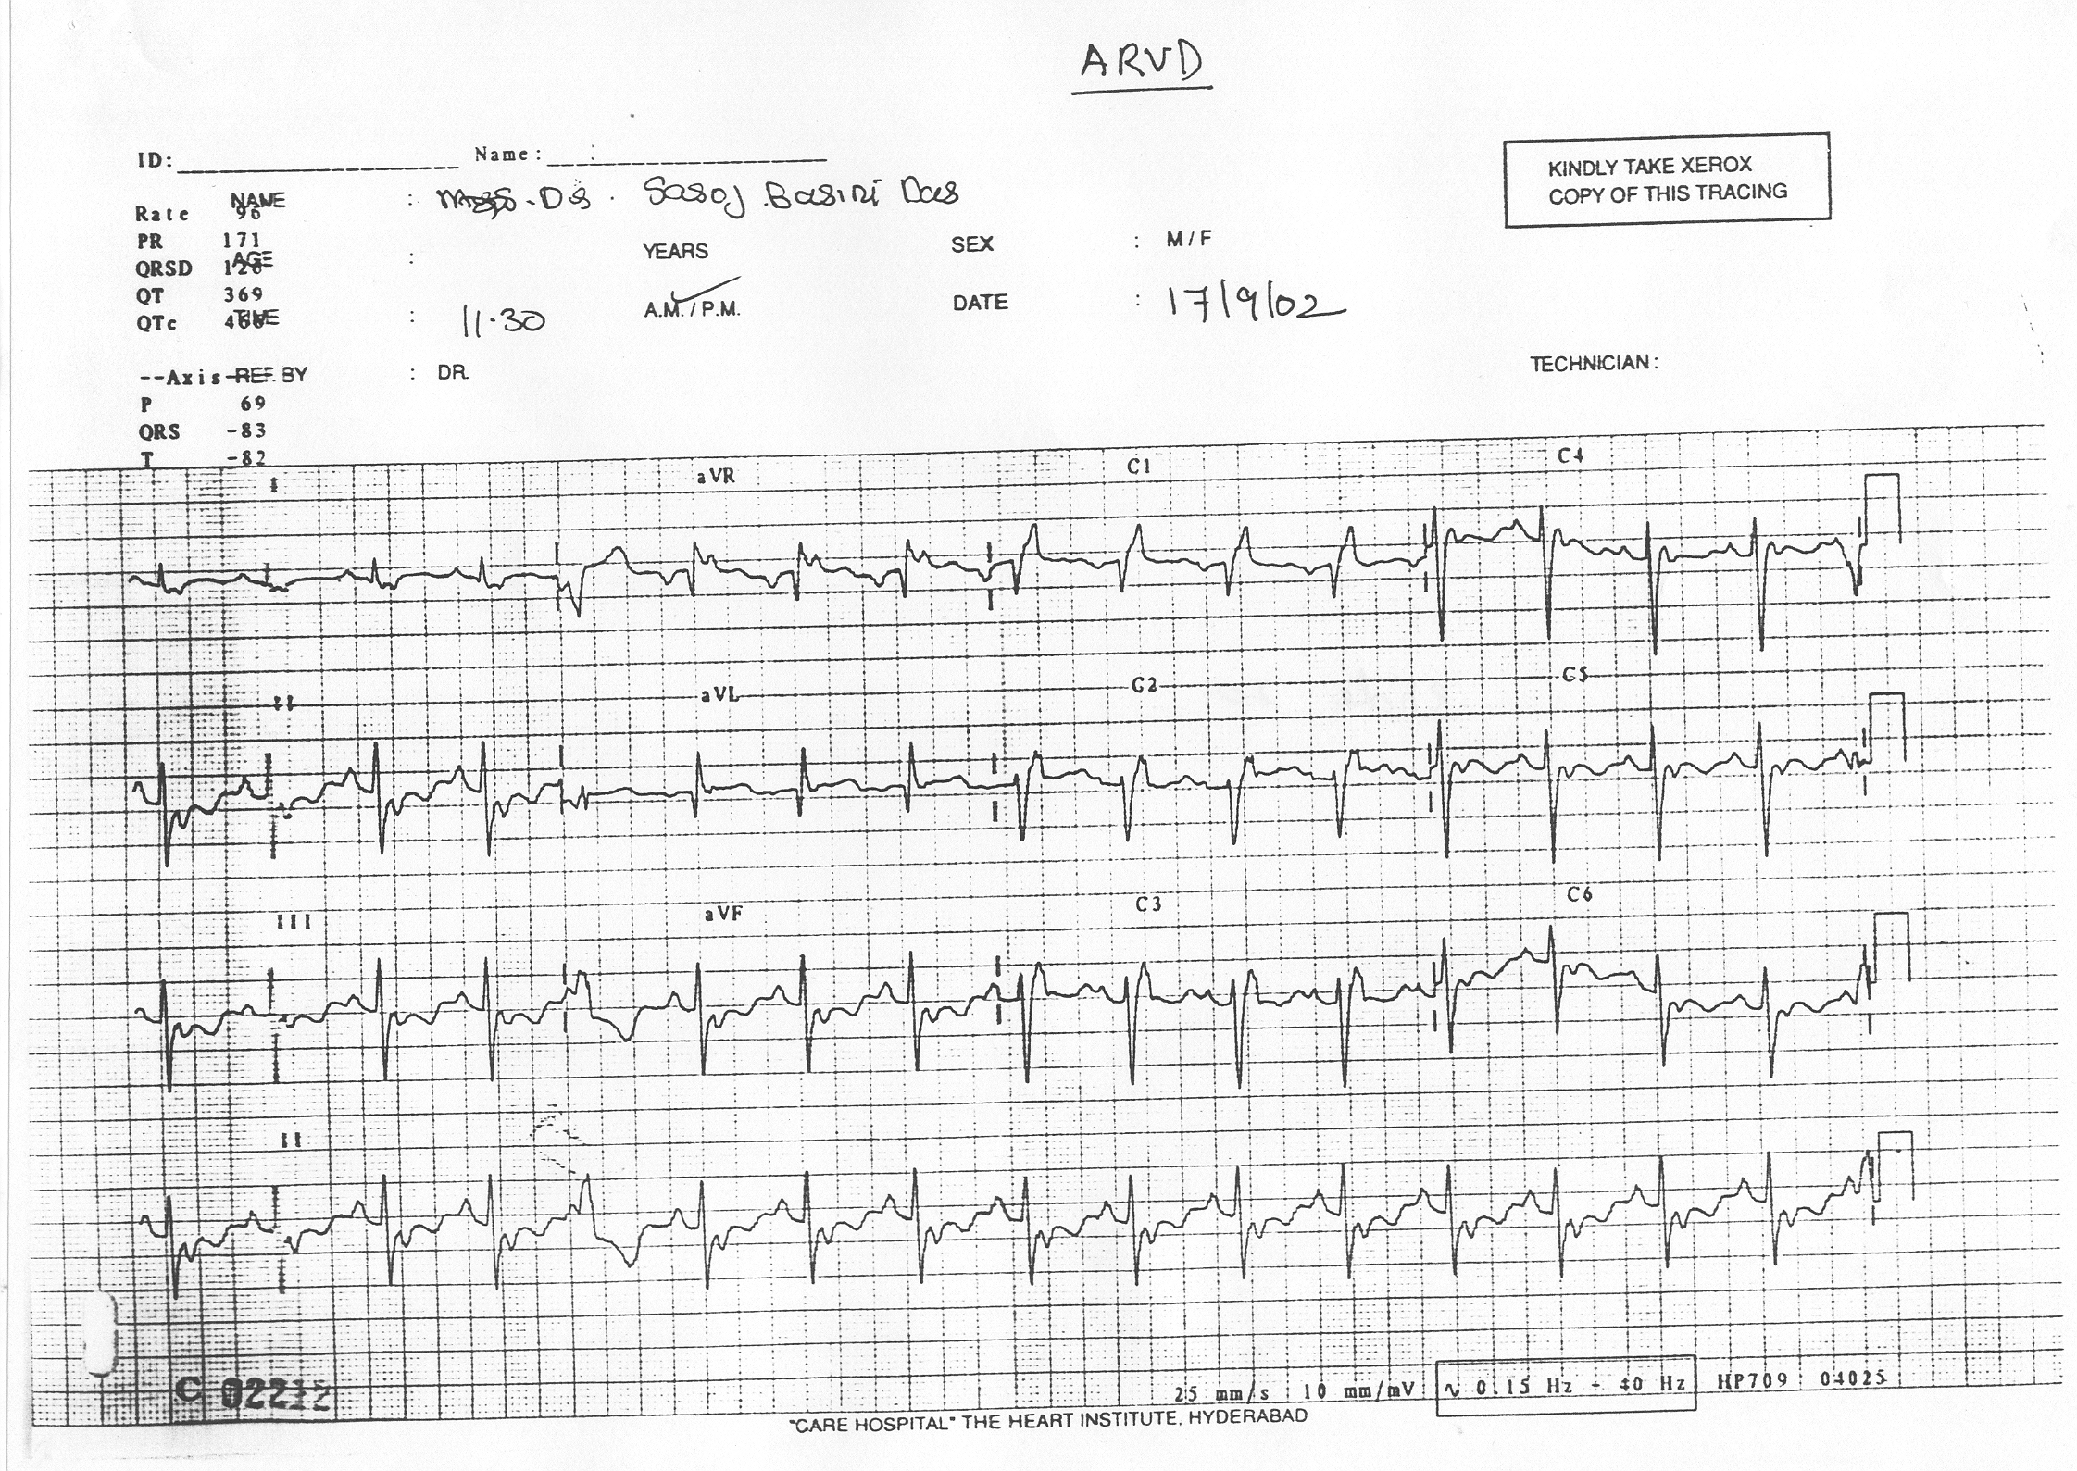
J Point Elevation….
EPSILON WAVE IN ARVD

Slide 9
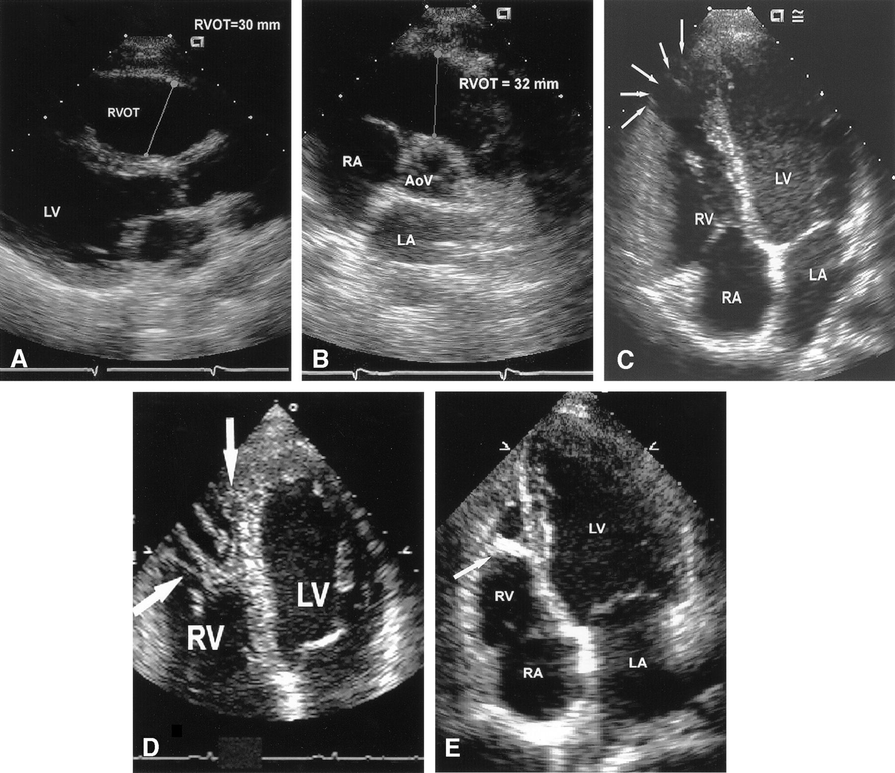
ARVD- LBBB Morphology VT
ARVD: Echo

Slide 10
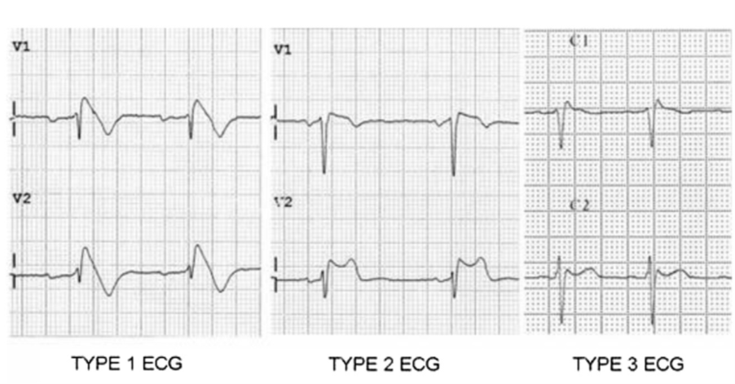
Brugada Syndrome
J Point Elevation….
ST elevation V1-V3, “RBBB”: Second R wave is an accentuation of J wave. (hence no S wave in left precordial leads).
Notes:
1. Type 1 BrS is diagnosed in patients with ST segment
elevation >2 mmin > one lead among the right precordial
leads V1eV3, followed by negative T wave, positioned in
the 2nd, 3rd or 4th intercostal space occurring either
spontaneously or after provocative drug test with intravenous
administration of Class I antiarrhythmic drugs.
2. Type 2 BrS: characterized by saddleback type ST segment
elevation of more than 2 mm a trough and a positive or
biphasic T wave.
3. Type 3 BrS: characterized by saddleback or coved type ST
segment elevation <1 mm.

Slide 11
J wave genesis: Action potential in normal and J wave syndrome

Slide 12
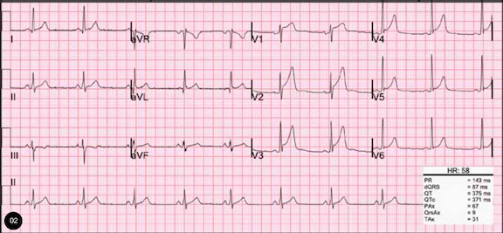
Early Repolarization Syndromes
J Point Elevation….
B.Malignant type with horizontal/descending type
A. Benign type with rapidly ascending ST

Slide 13
Case Scenario 3:
65 year old lady.
Known hypertensive & diabetic.
On stamlobeta & amifru.
Presented to ER with shortness of breath & severe fatigue.
O/E: PR 28bpm, BP 80/50 mm Hg.
RBS 199mg/ dl. S Cr 2.3mg/dl.

Slide 14
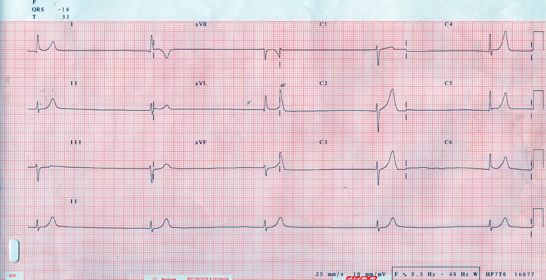

Slide 15
What is the Diagnosis?
Hyperkalemia.
Her Serum Potassium: 7.0 mEq/L.

Slide 16
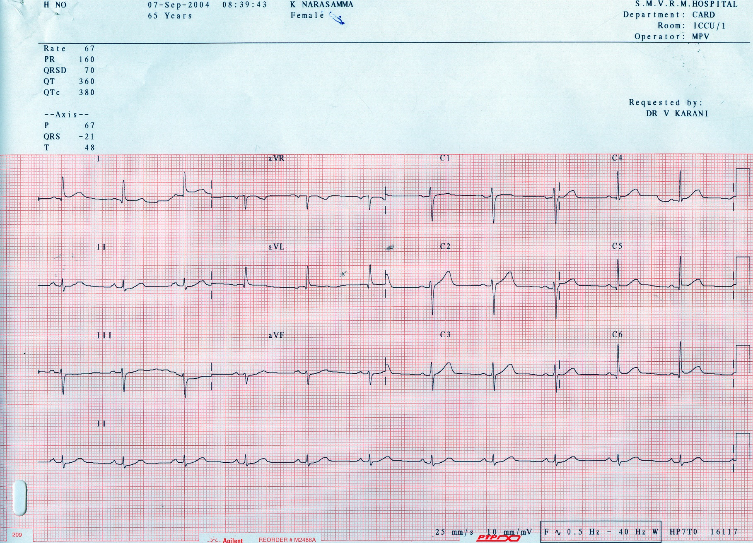
After Correction

Slide 17
HYPERKALEMIA
Associated with a distinctive sequence of ECG changes
The earliest changes are the appearance of peaked, narrow T waves and a shortened QT interval
Further changes of the ECG occur at a plasma K+ concentration > 7 to 8 mEq/L, and these changes are primarily due to delayed depolarization: widening of the QRS complex and decreased amplitude with widening and eventual loss of the P wave.
The final changes are a sine-wave pattern
Notes:
5.5-6: mild, 6.1-7: moderate, >7 severe.

Slide 18
Hyperkalemia- Treatment
IV Cal Gluconate
IV Dextrose-Insulin
Salbutamol nebulization
IV frusemide
Potassium binding resins – K bind with mannitol.

Slide 19
ECG 1
60 year old presents to ER with palpitation of 30 min duration
H/o recurrent palpitations last 20 years
Not on regular medication

Slide 20
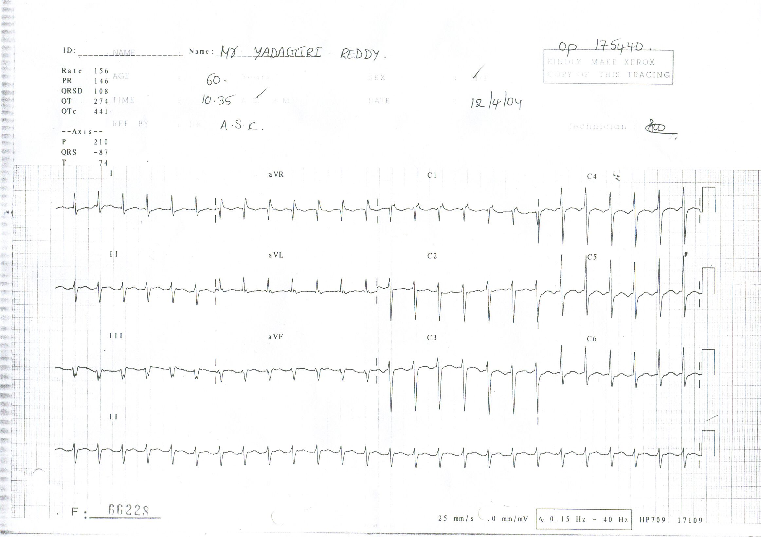
ECG 1: What is the Diagnosis?

Slide 22
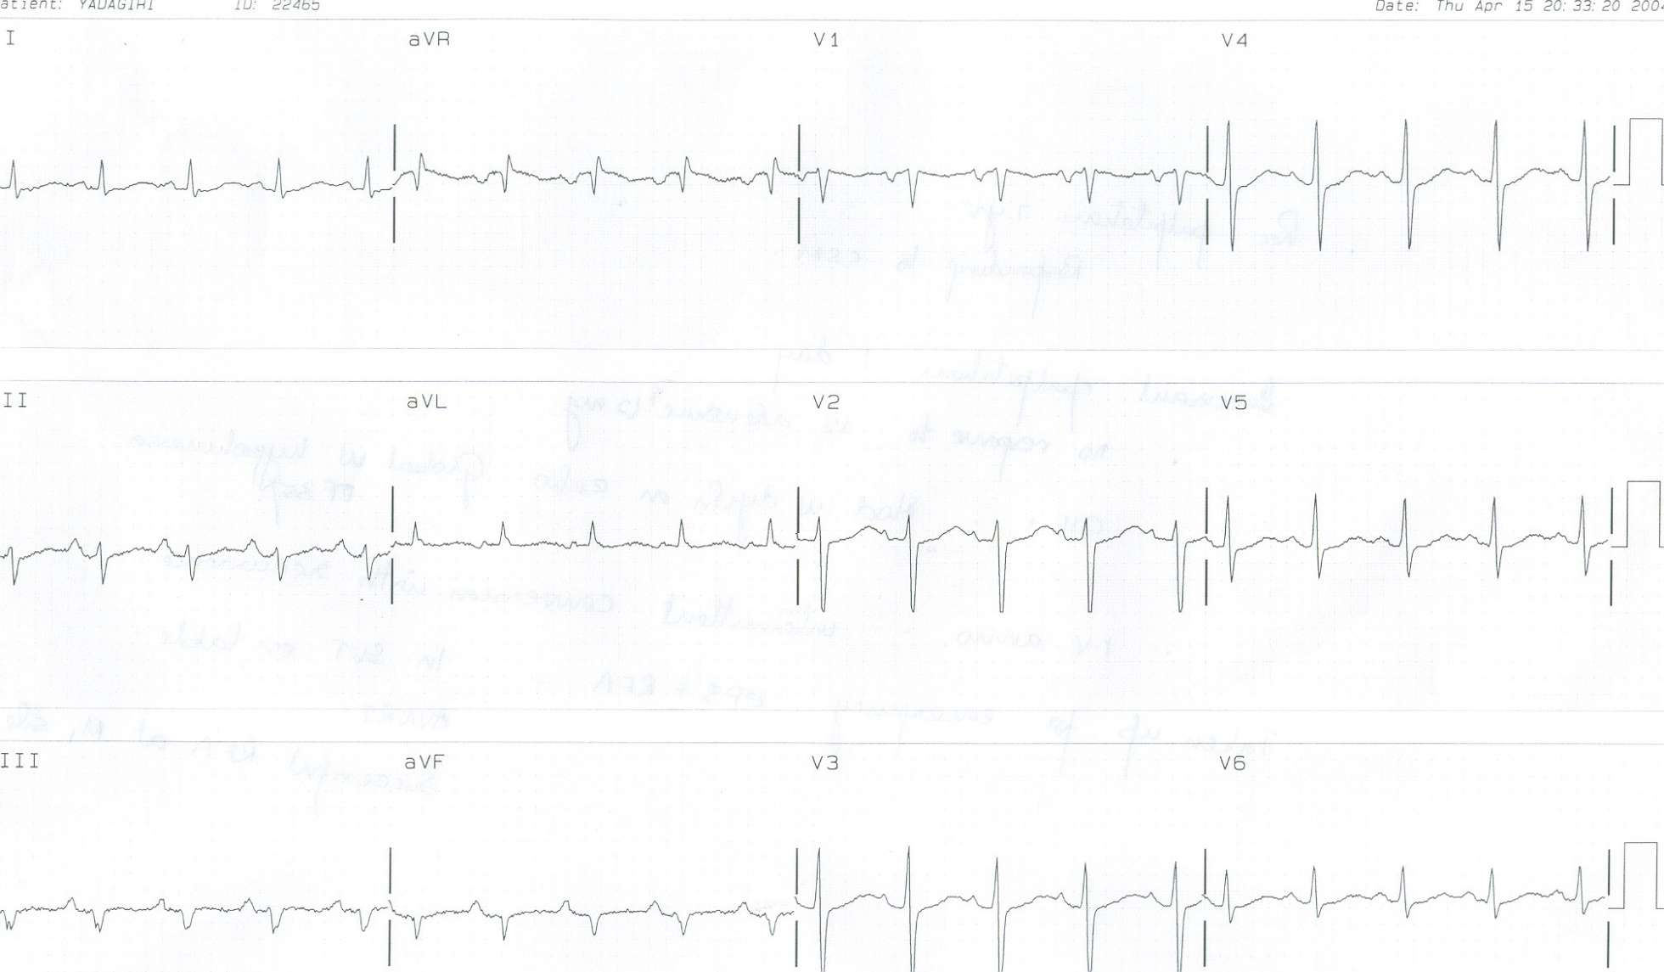
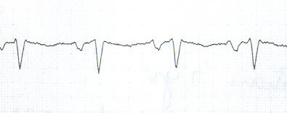
Post conversion

Slide 23
SVT
V1
V1
NSR

Slide 24
ECG 2
48 yr old woman
Presents to ER with palpitation of 15 min duration
H/O rec episodes since last 10 yrs

Slide 25
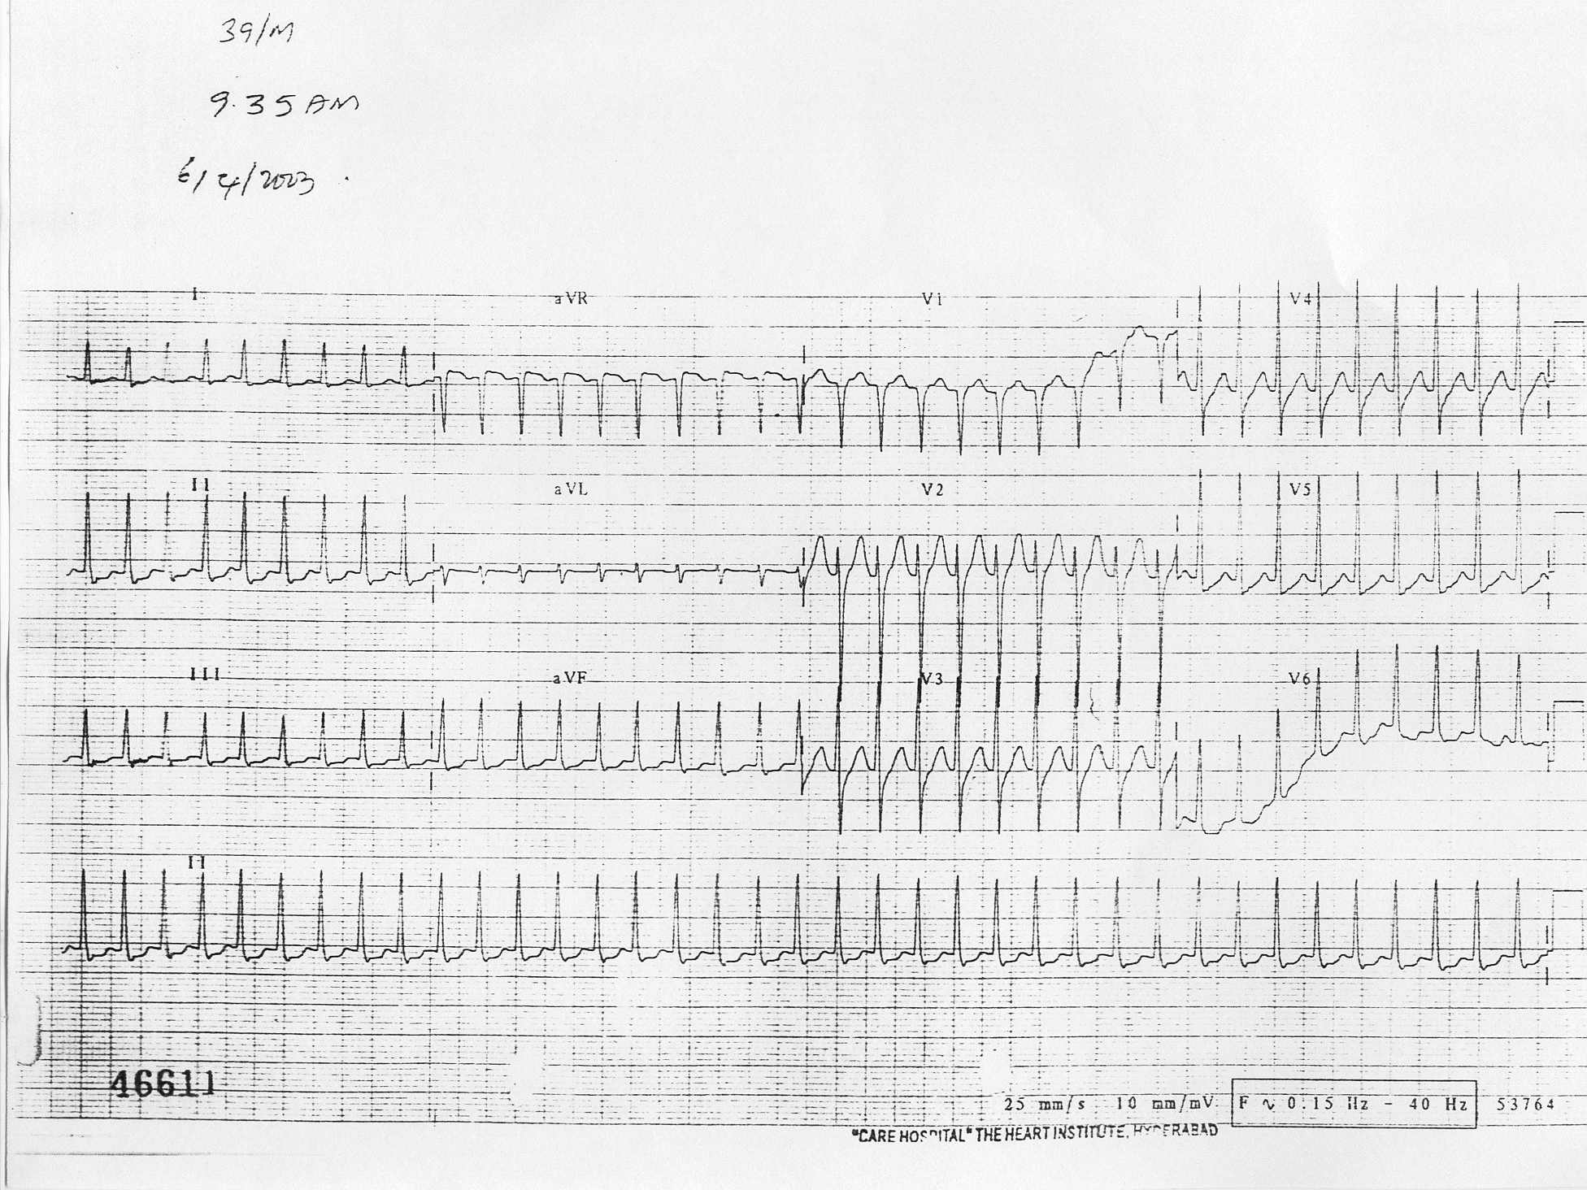
ECG 2:What is the Diagnosis?

Slide 27
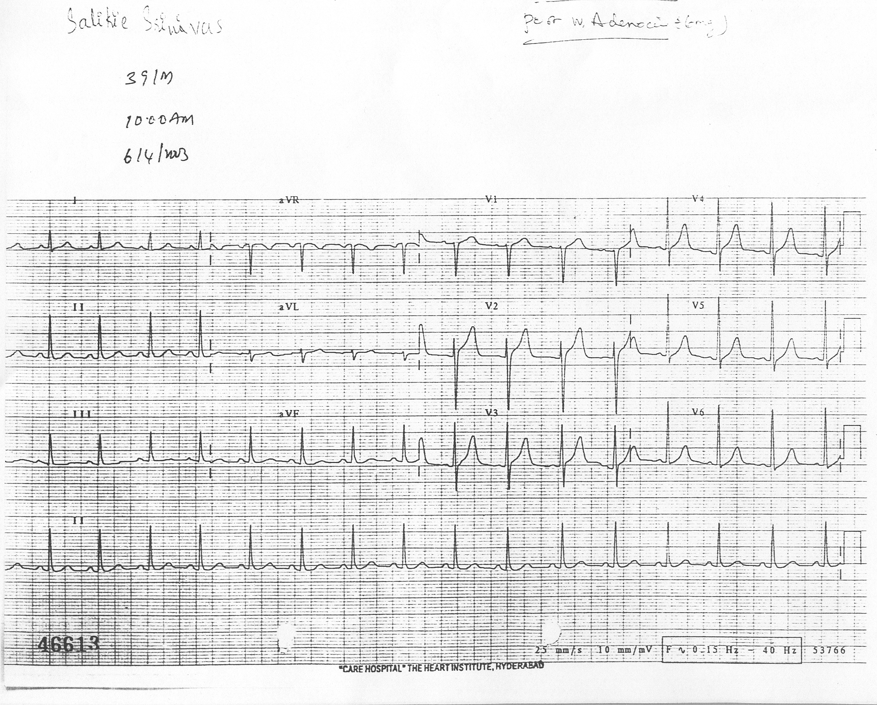
Post Conversion

Slide 28
LII: SVT
LII: NSR

Slide 29
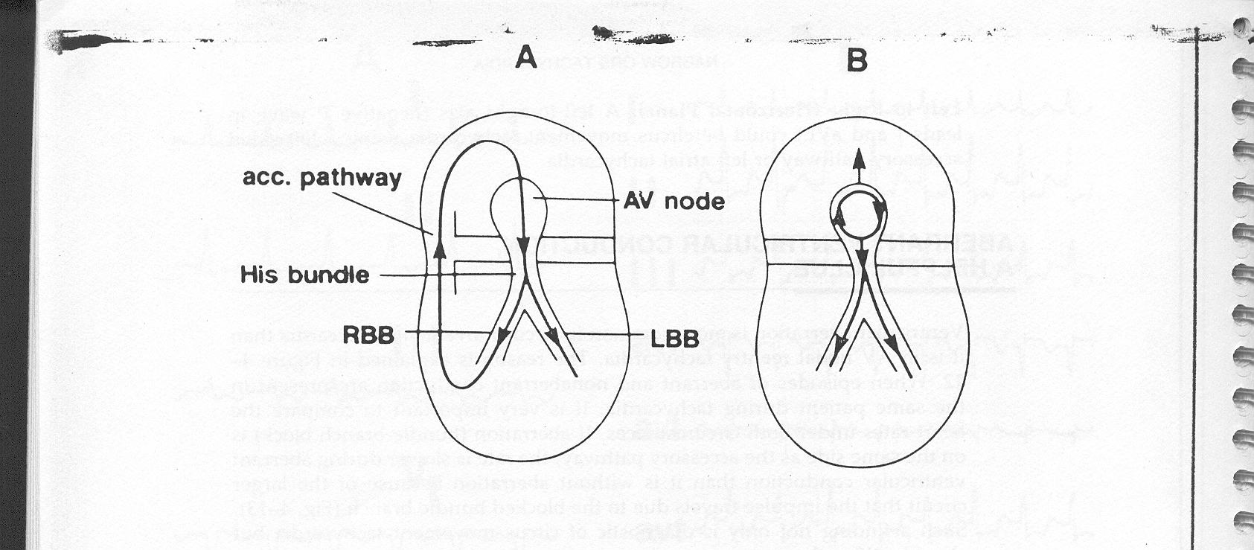
AVRT
AVNRT

Slide 30
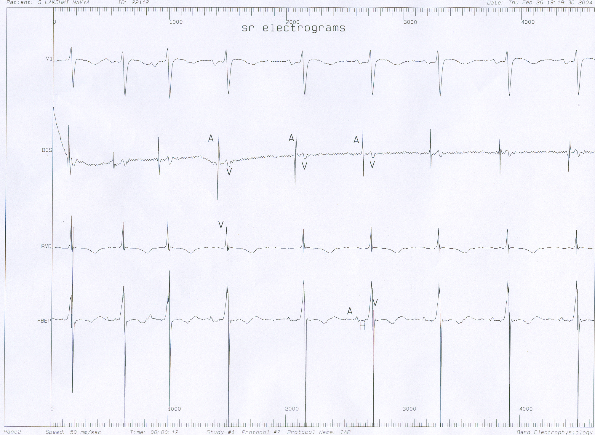

Slide 31
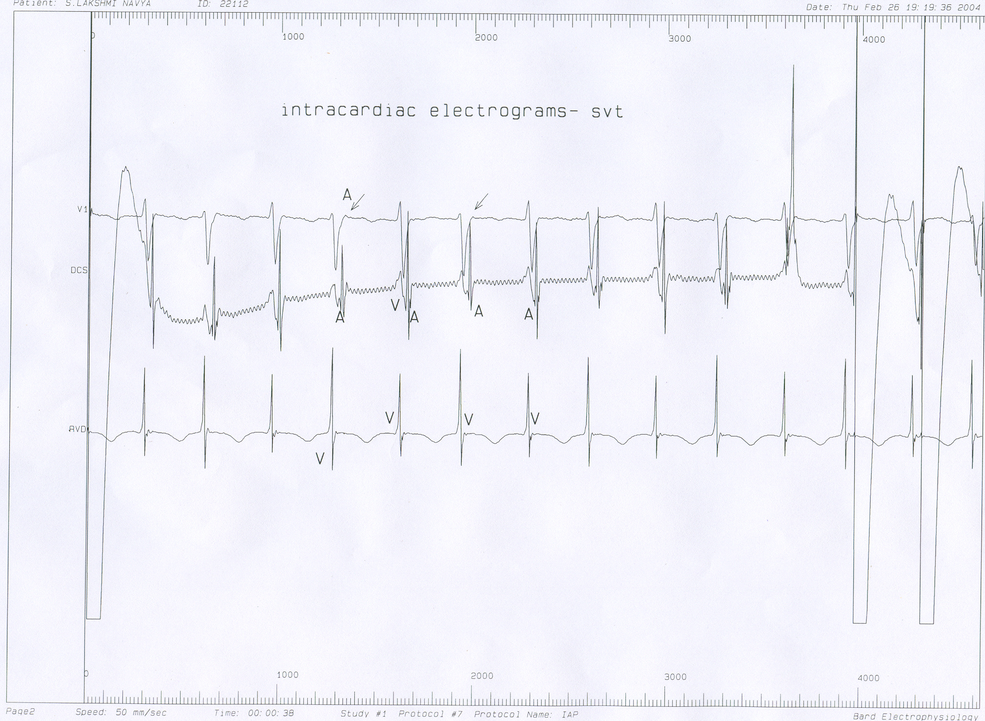
V1
DCS
RVA

Slide 32
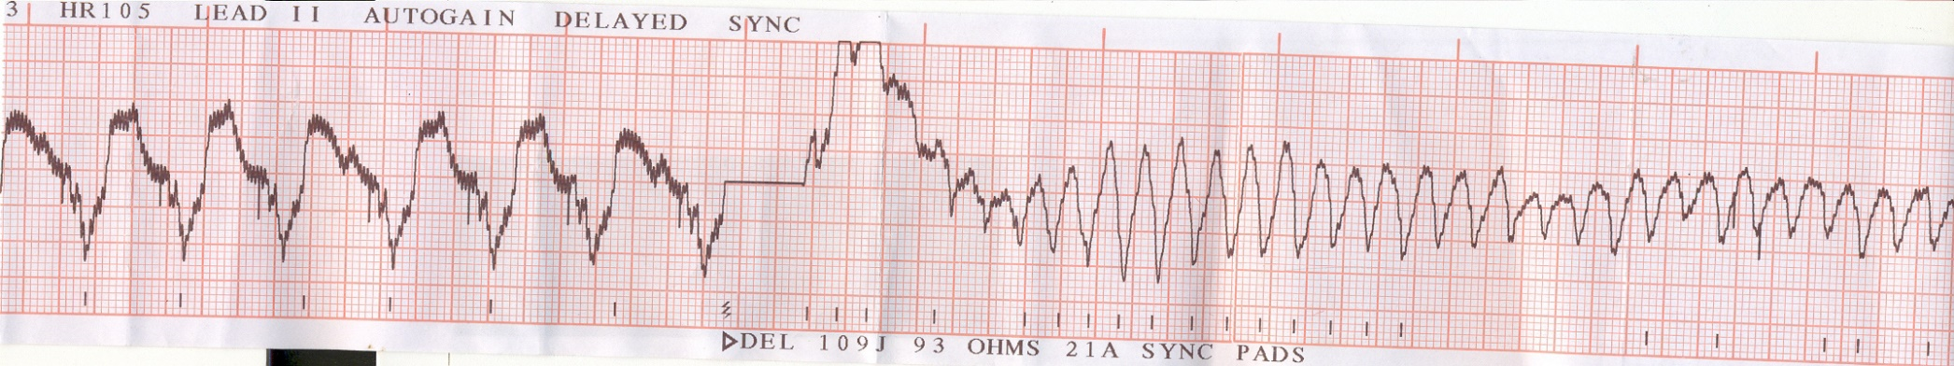
Case 1

Slide 33

THANK YOU

